Slide 1

Future Stem survey
By Hafsah Alkhammal, Kaden Furigay, Valery Peña, Olamide Oduntan, Kianna Desilva

Slide 2


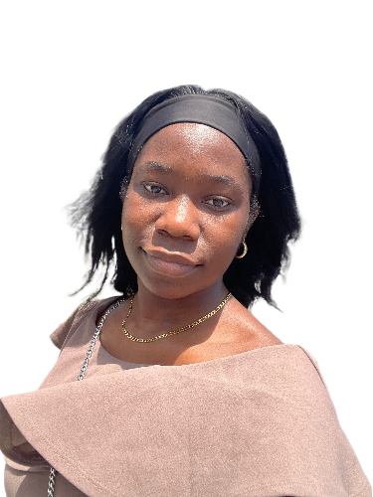
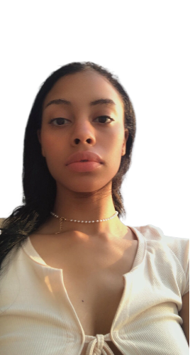
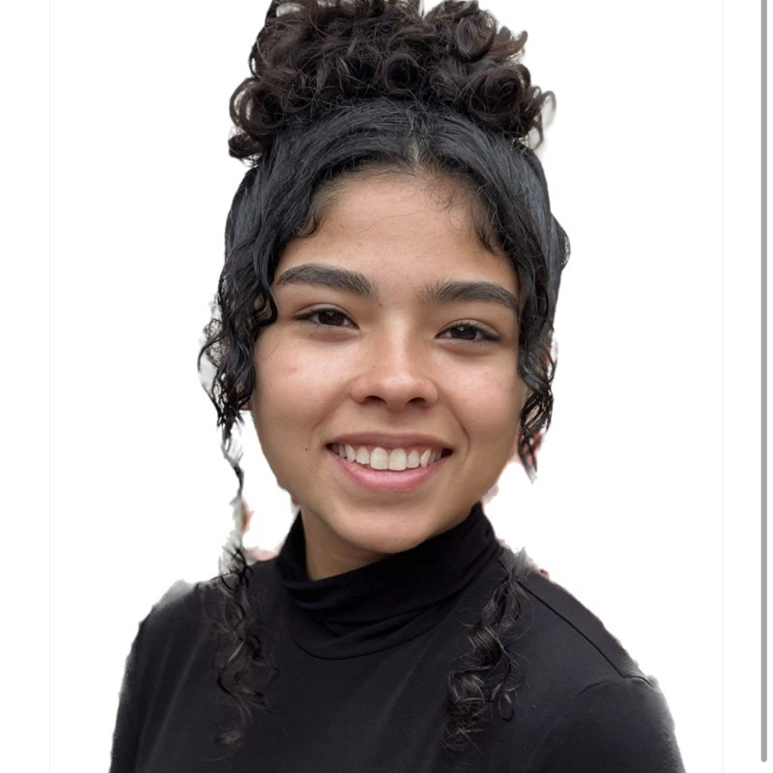
Development Team
Hafsah Alkhammal
Computer Science
Graduate May 2025
Kaden Furigay
Computer Science
Graduate August 2025
Olamide Oduntan
Computer Science
Graduate May 2026
Kianna Desilva
Information Technology
Graduate Spring 2025
Valery Peña
Cybersecurity
Graduate May 2025

Slide 3
Roles
Project Manager: Hafsah
Developer: Kianna
Survey Development Data collection/Survey Promotion: Valery/Olamide
Data Analyst: Kaden/Hafsah

Slide 4
Introduction
Our task was to create a survey which would help LexisNexis and executives understand what students in STEM careers expect of their future employers
This survey was generated through Typeform, a platform available online for professional use of surveys. We gained useful insights through this statistically significant and unbiased survey
We will be presenting our findings with a demo dashboard on PowerBI

Slide 5
Survey Scope Definition
The purpose of this survey is to gain insights into the perspectives of emerging diverse talent within the fields of computer sciences, software engineering, and data science.
The primary focus is on understanding the drivers that attract and retain individuals in these professions.

Slide 6
Scope
This survey was aimed to gather data on the preferences, values, and priorities of students pursuing careers in computer sciences, software engineering, and data science.
It will explore various factors influencing their choice of employers, including but not limited to company culture, compensation, professional development opportunities, and mentorship programs.

Slide 7
Key Components
Participant profile: The survey targets undergraduate and graduate students majoring in STEM fields.
Survey Questions: The survey consists of 20 questions, incorporating multiple-choice and ranking formats. Questions cover a range of topics including preferred company size, job opportunities, salary expectations, professional development preferences, mentorship, and benefits prioritization.
Focus Area: Factors influencing the choice of employers and importance of professional development opportunities, mentorship, and benefits.
Data Analysis: Data collected from the survey responses will be analyzed to identify trends, preferences, and priorities among respondents. Findings will provide guidance on areas of improvement to attract and retain talent in computer sciences, software engineering, and data science students.

Slide 8
Narrowing Down Choices
Initially included broader topics such as diversity, remote job options, and various employer offerings. Narrowed down to specific key components: Learning Opportunities/Resources and Work Compensation/Benefits.
Question Format: Initially included open-ended questions for qualitative insights but switched to closed-ended questions in form of multiple and ranking choices for more accurate and quantifiable data analysis.
Software used: Used Typeform based on recommendations and features we needed for the question, and we decided on using PowerBI because it is better for data analysis and visualization.

Slide 9
Decision-Making Process
Conducted independent research to understand current trends and preferences in the job market. Gathered and incorporated feedback from daily standups to refine our approach.
Designed the survey to be concise and not time-consuming, to accommodate students with short attention spans
Included topics and options that directly relate to the interests and priorities of STEM students. Aimed to gather actionable insights that reflect the actual needs and preferences of college individuals.

Slide 10
Development Process
BEFORE
AFTER
5 topic questions - 2 questions each
Learning opportunities
Work Compensation/Benefits
Inclusivity & Diversity
Remote options
Company culture & work environment
21 questions in total
These limited our analysis as we couldn’t get enough response from just 2 questions…
2 topic questions – 10 questions each
Learning opportunities/Resources(Mentorship & Professional Development)
Work compensation/Benefits
28 questions in total
With this number of questions including demographic questions, we were able to acquire enough responses for analysis.

Slide 12
Expected Outcome
Identify key drivers for attracting and retaining talent in critical fields.
Make informed decisions regarding recruitment strategies, professional development programs, and benefits offerings.
Address areas of improvement to better meet the needs and preferences of emerging diverse talent in computer sciences, software engineering, and data science.

Slide 13
Survey
We will now demonstrate the survey from the end user perspective
https://4jehrhdlaq9.typeform.com/stem-survey

Slide 14

Dashboard Design
Data Gathering: The data was collected using Typeform and then exported to CSV and XLSX file formats. We leveraged an API to directly extract this data from Typeform and processed it using Microsoft Fabric for efficient handling.
Power BI & Data Modelling: For in-depth analysis, we employed Power BI and data modelling to scrutinize the cleaned data, enabling us to generate impactful graphs and charts that visually depict our findings.
Cleaning Data: To maintain data quality and consistency, we meticulously cleaned the data using Fabric and PythonSQL, ensuring that our insights were based on reliable and accurate information.

Slide 15

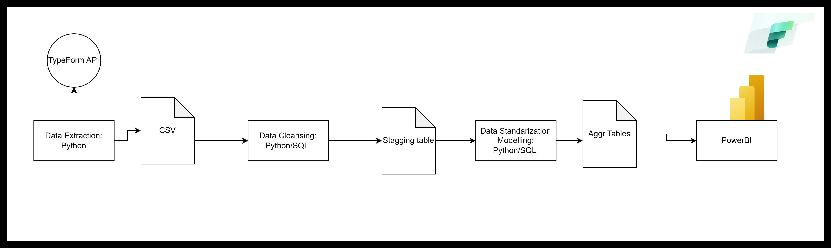
Data Process Diagram

Slide 16
Survey Design
Introduction - Welcome to the Future STEM Workforce Insights and Importance of Survey
Work Environment Preferences – 1 Question
Salary, Compensation and Benefits – 10 Questions
Professional Development and Employer Preferences – 9 Questions
Demographics – 8 Questions

Slide 17

Testing Survey
During the test survey, we successfully completed the initial survey within the first week and provided updates during the first two days of the following week. By Tuesday, the 14th of May 2024, we had effectively distributed the survey, resulting in approximately 130 valuable responses.
Pilot Survey
Friends
Family members
Final survey
KFSCIS Student List at FIU
Friends in STEM

Slide 18
Website Construction Overview
Before the virtual machine was set up, port 443 and port 80 were configured for the web server.
The website was made using AWS's Ubuntu Linux 12-month free tier
On the Ubuntu Linux virtual machine, WordPress was downloaded through the terminal using commands.
Word press's files are stored within the virtual machine

Slide 19
Website Construction Overview
After WordPress was successfully installed on the virtual machine, a site check was done to see what needed to be edited on the terminal: php was updated
A command was used to secure the website automatically every year.
Three plugins were used to design the site.
Elementor
Starter Templates
ImageMagick Engine

Slide 20
Website
We will now be demonstrating the website
Survey website link: https://stem-surve.com

Slide 21
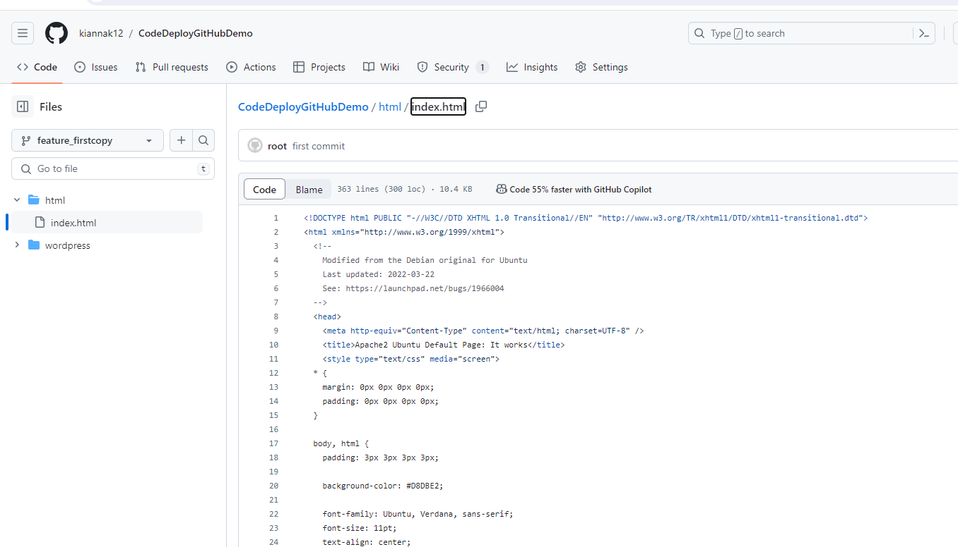

Vulnerabilities Detected
There were no vulnerabilities detected due to html not being a supported programming language for the code scanning tool
Amazon Inspector was also attempted, however since the virtual machine was Ubuntu Linux, it was listed as not supported
The last alternative was to used WordPress site check: the score given was good.

Slide 22
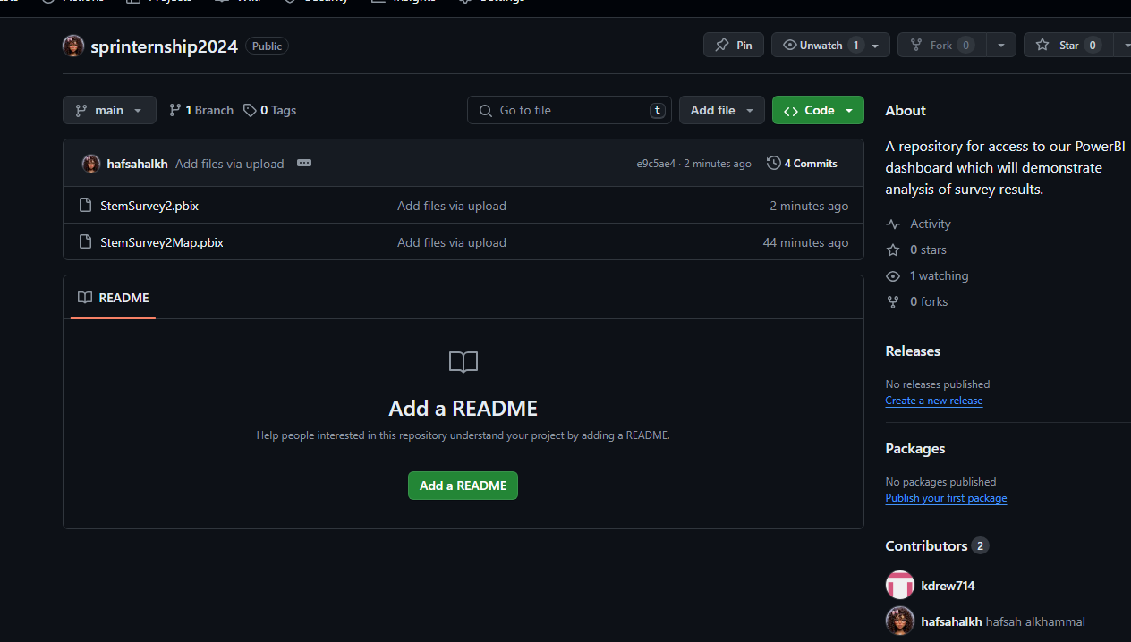
Using GitHub and Office 365

Slide 23

What Was Learned and Why AWS?
AWS was chosen to be the host of the web server because of the free 12-month tier, its scalability for tracking traffic, it provides a surplus of options to provide encryption, and its performance.
What I learned is how to check for vulnerabilities, using the GitHub repository, learning new commands to put the code into the repository, and to backup any changes I’ve made to the site. These practices help ensure that the application is secure and resistant to potential threats.
I learned new Git commands essential for effective version control, such as git add, git commit, git push, and git pull.

Slide 24
What We Have Learned
Communication and clarity was very essential during the internship
In data analysis, visualization is important in reading and understanding the data
Developed skills in formulating targeted survey questions tailored to our audience's needs.
Learned how to implemented various response choices including multiple-choice and ranking questions for comprehensive data collection

Slide 25
What We Have Learned
Utilizing a scheduled pipeline to refresh data is more efficient than repeatedly uploading different Excel sheets.
The use of Python and SQL for data cleaning has proven to be significantly more efficient.
Although challenging, mastering the navigation of Power BI has been rewarding, particularly in understanding the various visualization options for data representation.
The significance of data cleaning has become even more apparent than I initially realized.

Slide 26
Shocking? Yes, it is!!
Medium-sized companies
Is LexisNexis a large or medium size company?
Skillset used
Flexible Work

Slide 27
Enhancement of Implementation
Use of PowerBI to visualize analysis
Use of Fabric and PythonSQL to clean data
Scheduled a refresh call to API to ingest data from survey

Slide 28
Some Insights
80% of students prefer a hybrid mode of work arrangement
44% of students prefer a salary range between $90-120k while 30% of students prefer $130k+
66% of students find developing their technical skills to be the most important aspect of professional development
56% of students find hands on projects to be the most attractive aspect of professional development opportunities
42% of students prefer to meet with their mentors weekly

Slide 29
Future Implementations…
Expand Geographic Reach: Broaden survey distribution beyond Florida to capture a more diverse and representative sample.
1
Increase Participation: Offer incentives for survey completion. Partner with other universities and professional organizations to reach a wider audience.
2
Enhance Survey Design: Mix qualitative and quantitative questions to capture nuanced insights.
3
Targeted Outreach: Focus outreach efforts on underrepresented groups in tech to ensure diverse perspectives are captured
4

Slide 30
Survey Limitations
Included participants were mostly from Florida, which may not accurately represent the perspectives of emerging diverse talent across the entire United States
The survey focuses specifically on the perspectives of individuals pursuing careers in STEM
The findings may not represent the views of the broader workforce or other industries
The survey's sample size may have been relatively small, which limits the statistical power of the results

Slide 31
THANK YOU!
We will now move to the survey and website demo

